Slide 1
Autonomous Wheelchair using Structured Light
Michael Hodgson
John Charlesworth

Slide 2
Contents
Aims
Structured Light
Original 2D Investigation
3D Point Cloud
Point Cloud Library
Voxel Grid
Floor Removal
Clear Direction
Pathfinding
Demo
Questions

Slide 3
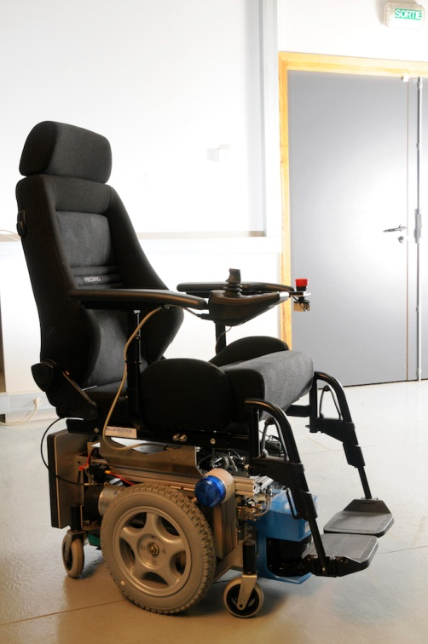
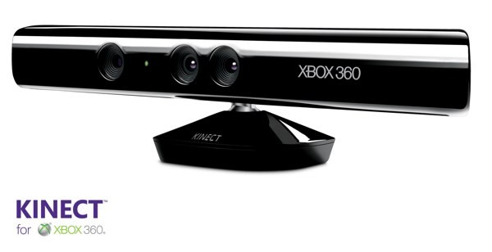
Aim
To provide obstacle detection and avoidance using structured light
+
= ?

Slide 4
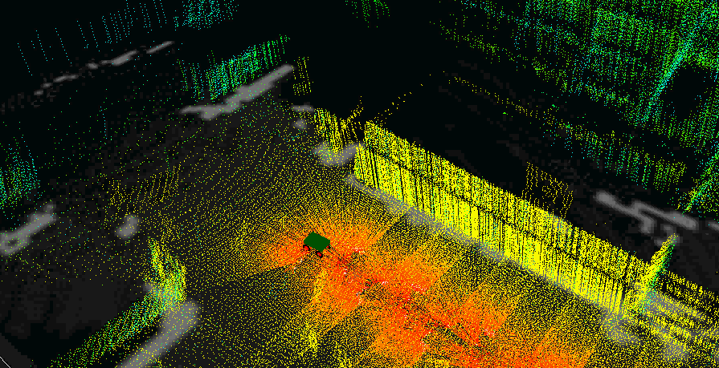
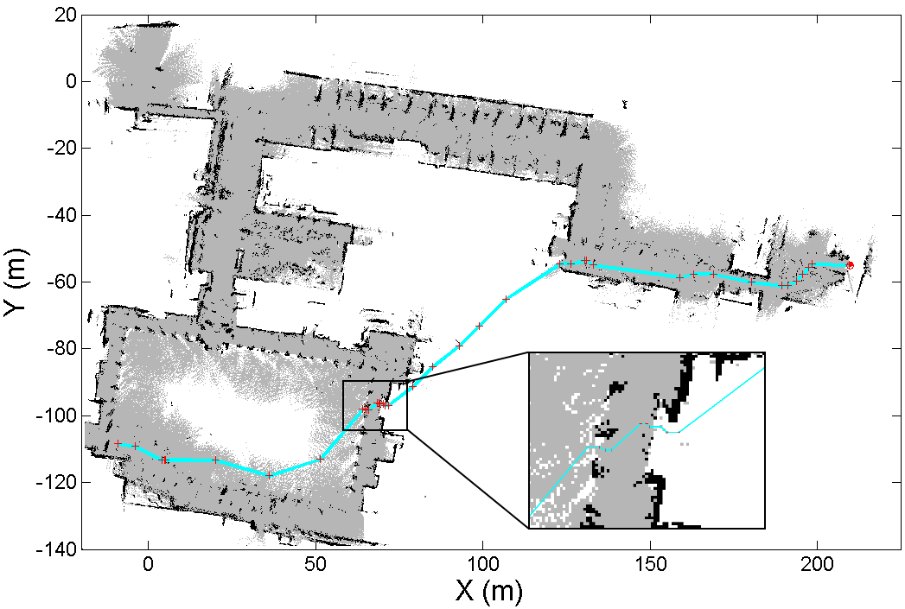
Previous Work Example
Autonomous Navigation Using a Real-Time 3D Point Cloud. Whitty, M. et al. Australasian Conference on Robotics and Automation. 2010
Complex system using multiple robots with laser scanners, IMU and SLAM techniques
Uses occupancy grid and path finding

Slide 5
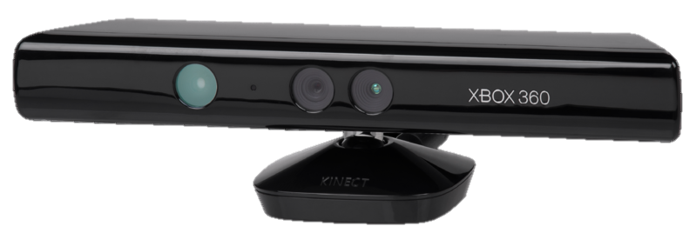
Structured Light (Kinect)
We are using the Microsoft Kinect
Structured light 3D sensor
Works by:
Projecting a pattern (IR laser grid)
Observing how this is distorted when viewed from another view point (IR CMOS sensor)
Laser
IR Sensor

Slide 6
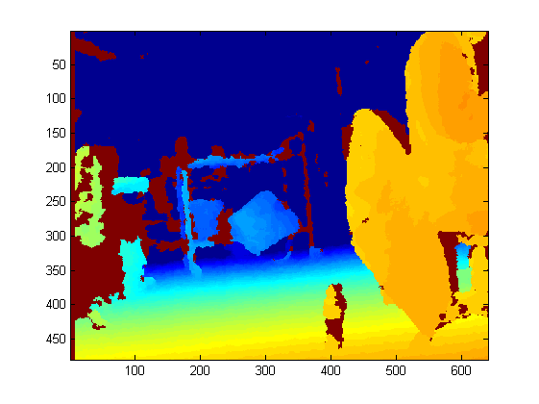
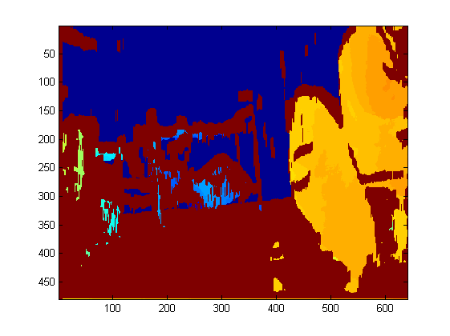
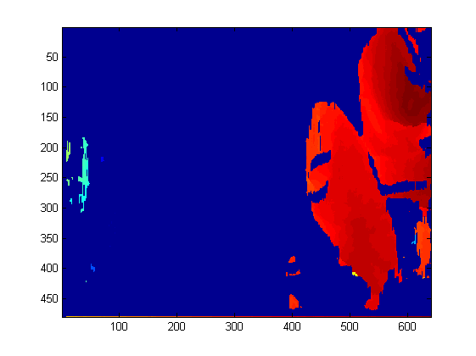
Original 2D Investigation
Data captured by screenshot, then microsoft SDK and finally openNI viewer
Transferred to MATLAB for processing:
Floor removal
Depth thresholding
Raw depth data
Floor removed
Depth thresholded

Slide 7
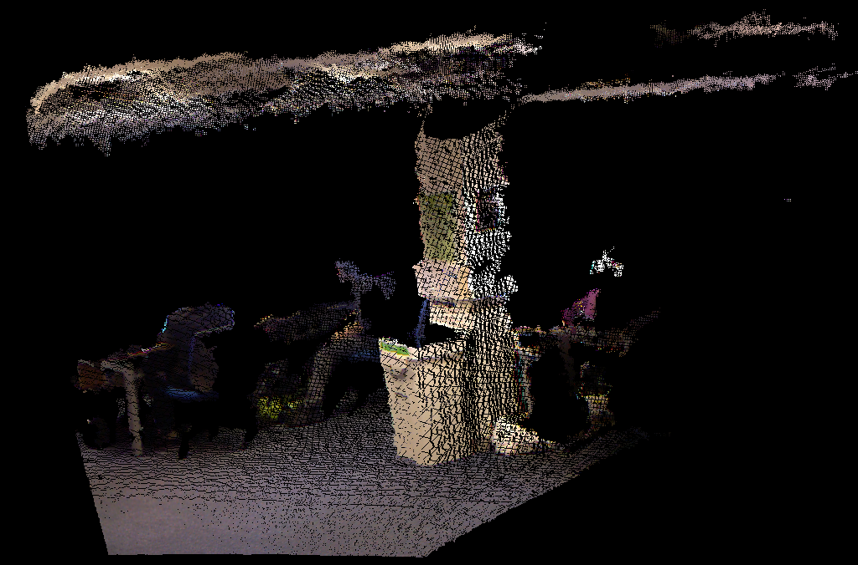
3D Point Cloud
The structured light sensor generates a point cloud

Slide 8
3D Point Cloud – Method Overview
Point Cloud
Voxel
Floor Detection
Clear Direction
Occupancy Map
Pathfinding

Slide 9
3D Point Cloud
Point Cloud
Voxel
Floor Detection
Clear Direction
Occupancy Map
Pathfinding

Slide 10

3D Point Cloud – Point Cloud Library
The Point Cloud Library (PCL) was used in this project
The PCL is a C++ library for manipulating point clouds
It provides access to a wide range of functions in areas such as filtering, segmentation and visualisation.
http://pointclouds.org/

Slide 11
3D Point Cloud
Point Cloud
Voxel
Floor Detection
Clear Direction
Occupancy Map
Pathfinding

Slide 12
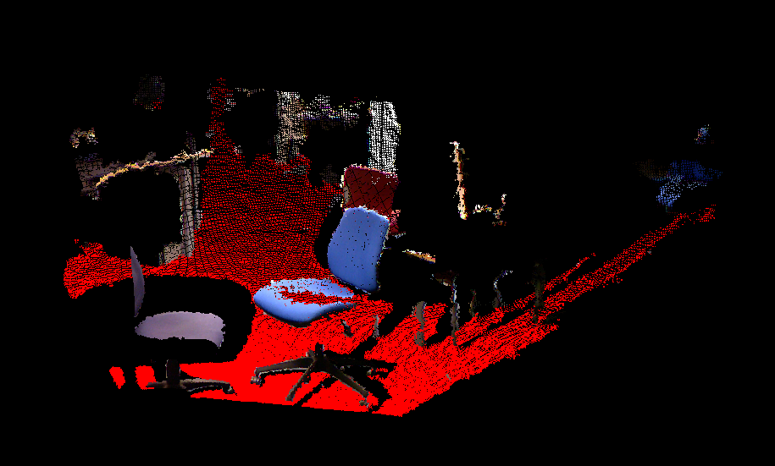
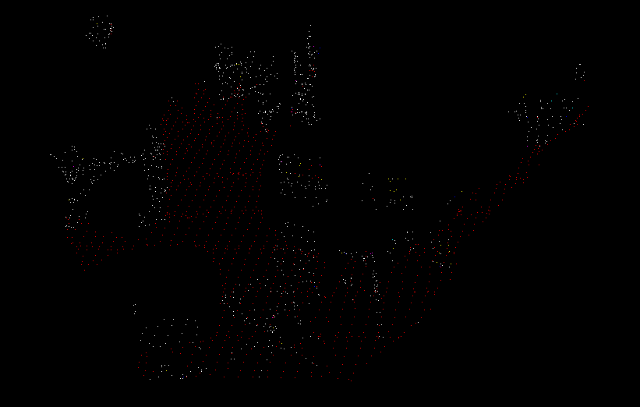
3D Point Cloud - Voxel Grid Downsampling
Reasons we downsampled in a uniform grid:
Speed (too many points)
Larger point density close to Kinect
PCL’s built in filter creates a 3D voxel grid over the point cloud data
Downsamples using centroids of all points in voxel^{[1]}
[1] http://docs.pointclouds.org/trunk/classpcl_1_1_voxel_grid.html#_details

Slide 13
3D Point Cloud
Point Cloud
Voxel
Floor Detection
Clear Direction
Occupancy Map
Pathfinding

Slide 14
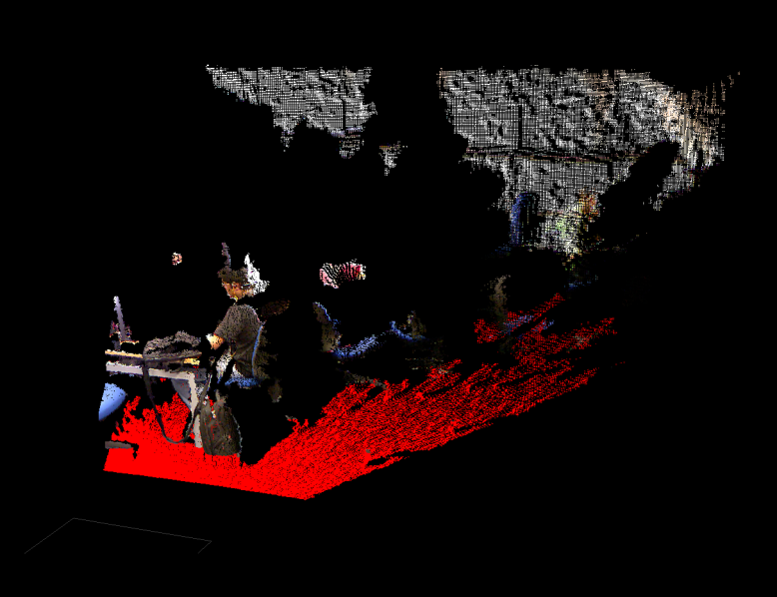
3D Point Cloud – Floor Detection
Different methods were used to detect the floor
Based on comparison with planes
First Method: manually sweep through planes (slow)
Second Method: manually remove ceiling and use RANSAC algorithm
Notes:
Top image brute force, bottom RANSAC

Slide 15
3D Point Cloud
Point Cloud
Voxel
Floor Detection
Clear Direction
Occupancy Map
Pathfinding

Slide 16
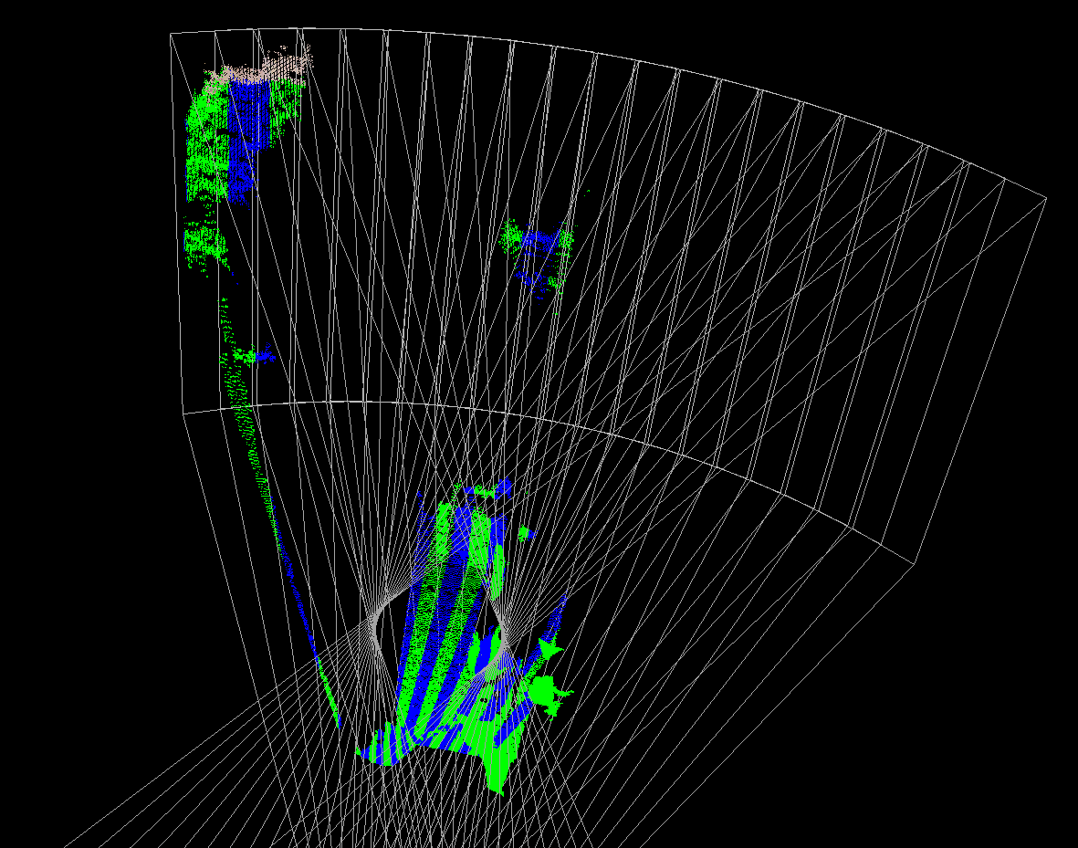
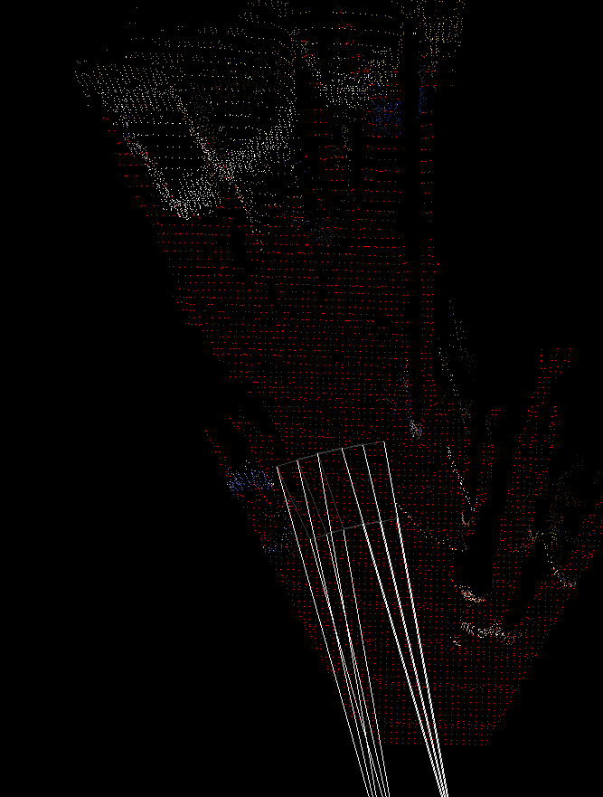
3D Point Cloud – Clear Direction
Calculation of clear directions
Method:
Box is swept across scene
Floor points and obstacle points within box counted
Boxes with floor points above a threshold and obstacle points below a threshold are marked as clear and displayed
Box length variable

Slide 17
3D Point Cloud
Point Cloud
Voxel
Floor Detection
Clear Direction
Occupancy Map
Pathfinding

Slide 18
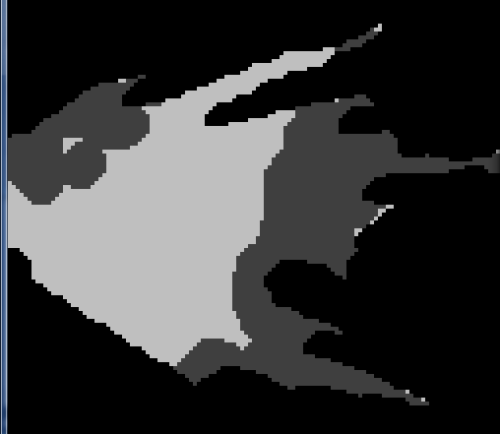
3D Point Cloud – Occupancy Map
A 2D Occupancy map was constructed
Method:
Floor captured, dilated and marked as passable
Obstacle points captured, dilated and marked as impassable
Dilation to account for wheelchair width

Slide 19
3D Point Cloud
Point Cloud
Voxel
Floor Detection
Clear Direction
Occupancy Map
Pathfinding

Slide 20
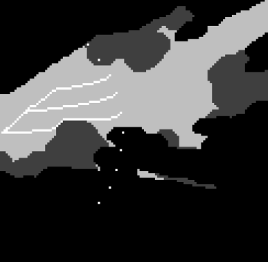
3D Point Cloud - Pathfinding
Using occupancy map
Pathfinding done using the A* algorithm
Single start point, multiple radial finish points
Finish point distance variable

Slide 21
For Your Information – A* (A Star) Search Algorithm
Faster extension of Dijkstra's algorithm
Space represented as 2D array with each cell either passable or impassable
Uses a distance-plus-cost function to determine which nodes to search next:
Function of cost from start cell to current cell
Plus estimated distance from current cell to finish
http://en.wikipedia.org/wiki/File:Astar_progress_animation.gif

Slide 22

Demonstration

Slide 23
Technical Summary
Detection range: up to 5m (reliable)
Configurable detection length: 2 – 5m
Lanes sweep across 30º field of view in 20 steps
Average frame rate:
Without pathfinding: ~4 fps
With pathfinding: ~0.5 fps

Slide 24
Summary
Point Cloud Extracted
Clear Directions Selected
Pathfinding Implemented
Further Work:
SLAM integration
Interfacing with a robot
GPS integration

Slide 25
Source Code
We have used a Git repository to store our source code
Homepage: https://github.com/michaelwh/kinect-wheelchair
Download the latest code, test images and test/development log (zip): https://github.com/michaelwh/kinect-wheelchair/zipball/master

Slide 26
Testing and Development: Further Info
We have kept an online log of the development of this project with plenty of testing detail
Please see it at https://docs.google.com/document/d/1Mtvac63xoO_FK9xakpljxqftgFCKUsIqAUdaZ14av8U/edit
It is also in the git repository

Slide 27
Resources Used
http://www.araa.asn.au/acra/acra2010/papers/pap151s1-file1.pdf
Talks about navigating using an occupancy grid and point cloud
http://www.ipb.uni-bonn.de/uploads/tx_ikgpublication/Plane_Detection_in_Point_Cloud_Data.pdf
A couple of plane detection algorithms for point clouds
Point Cloud Library (PCL) http://pointclouds.org/
We use this for a lot of things in our algorithms including voxel grid downsampling, plane detection using RANSAC and visualisation of point cloud data - this is an excellent library with a huge number of features, although it is still quite rough around the edges, inconsistent and difficult to use at times.
http://svn.pointclouds.org/pcl/trunk/visualization/tools/openni_viewer.cpp
Our implementation has been based on the framework provided by this code which extracts point cloud data and image data from a Kinect and displays it on screen
http://code.activestate.com/recipes/577457-a-star-shortest-path-algorithm/
The code for the A* pathfinding algorithm used was taken from here.

Slide 28

Any Questions?

